Slide 1
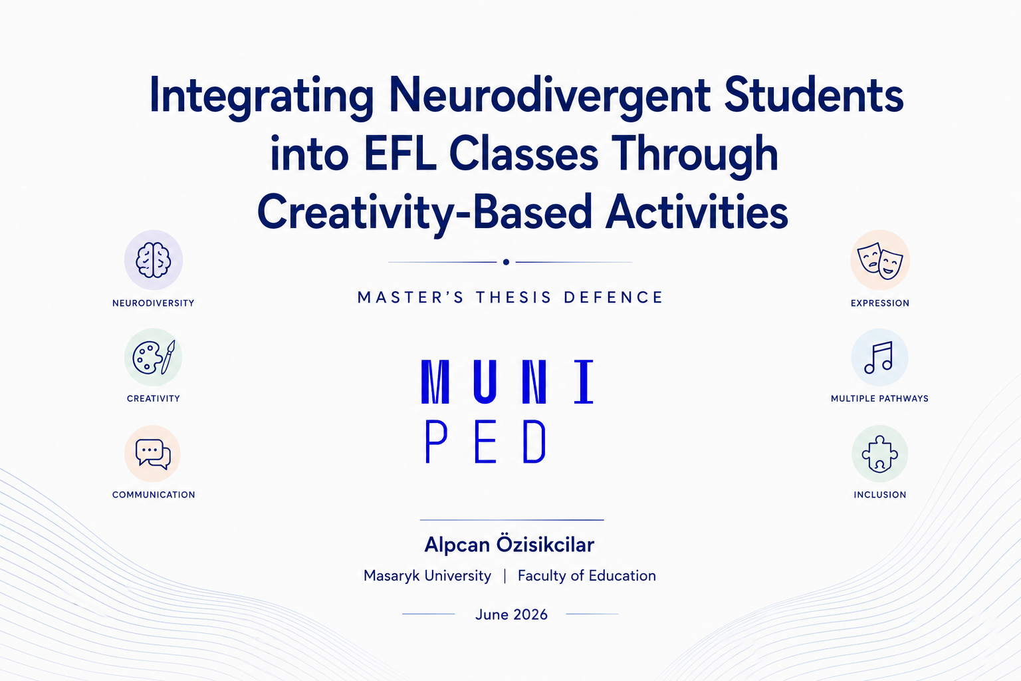


“What if some students are not struggling to learn, but struggling to show what they know?”

Slide 2
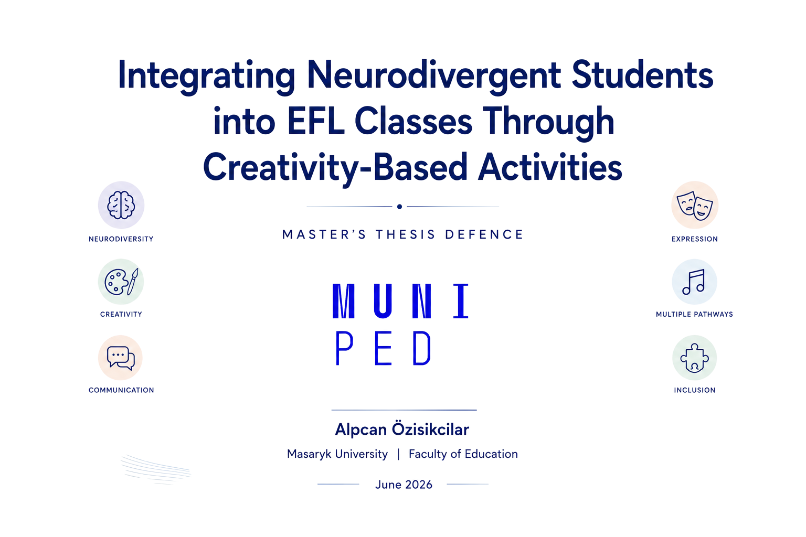
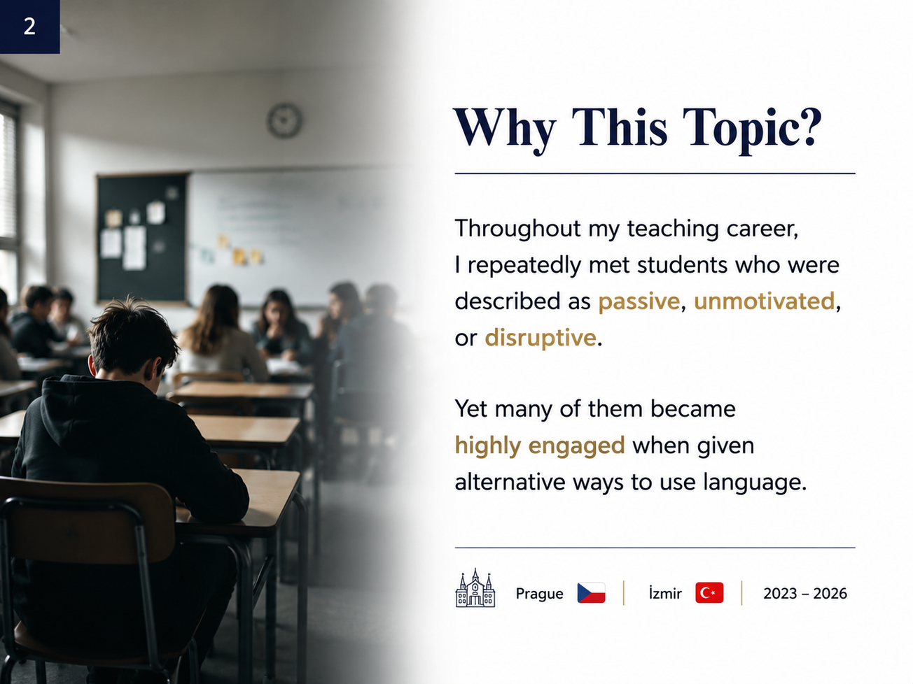

Slide 3
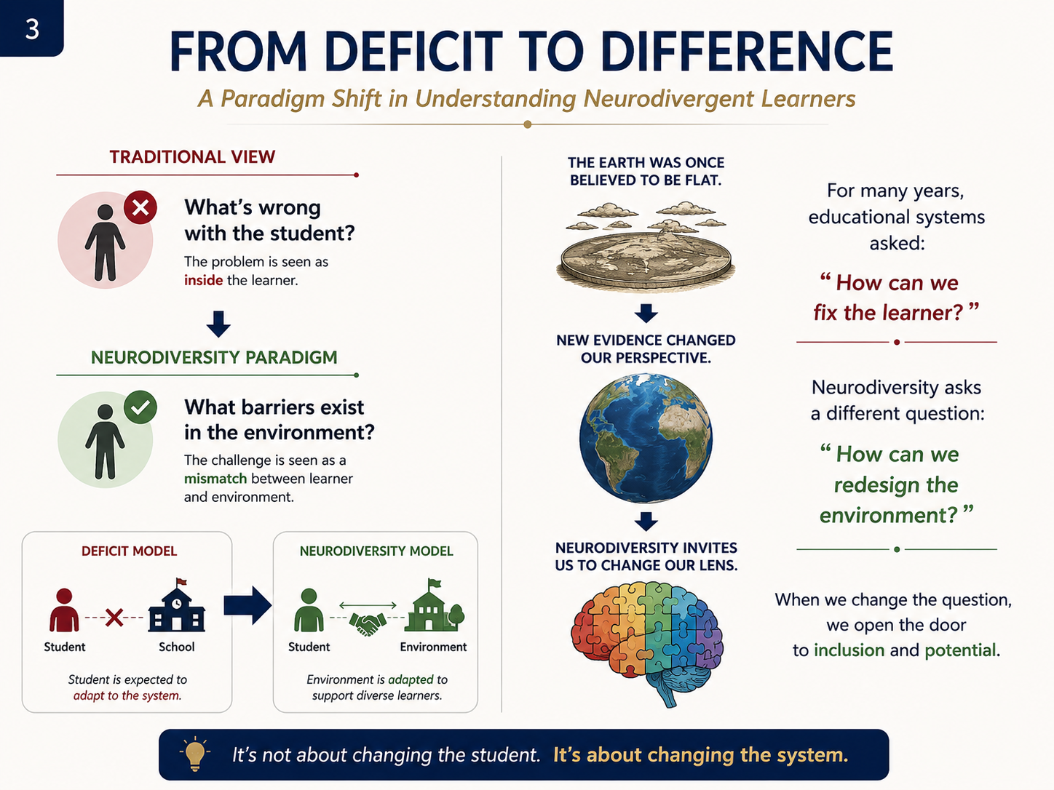

Slide 4
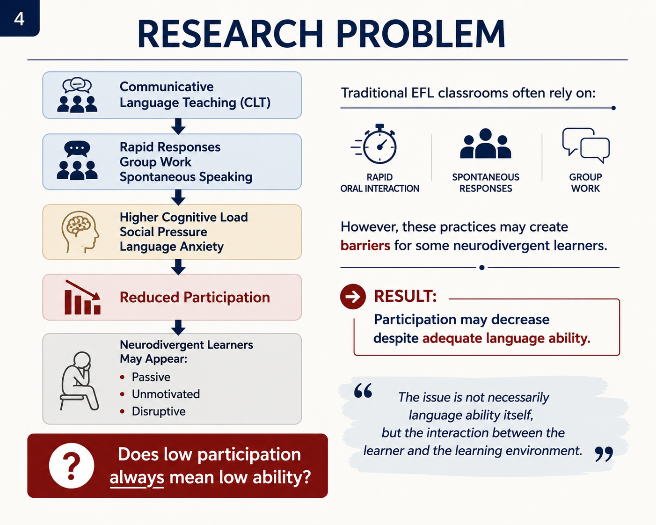

Slide 5
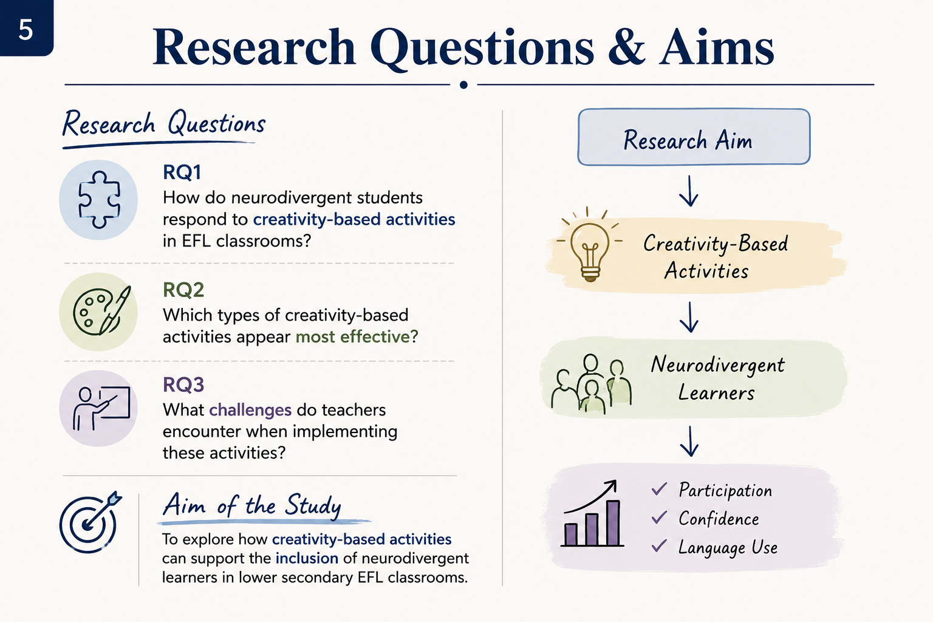

Slide 6
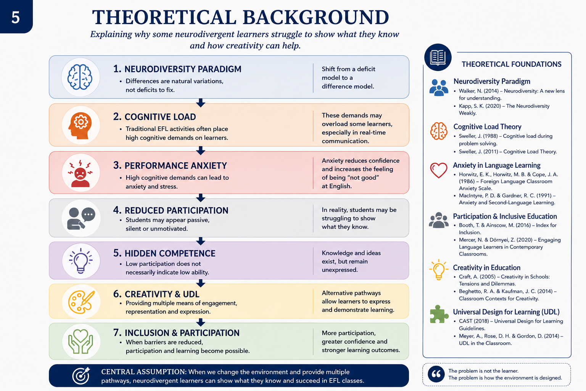

Slide 7
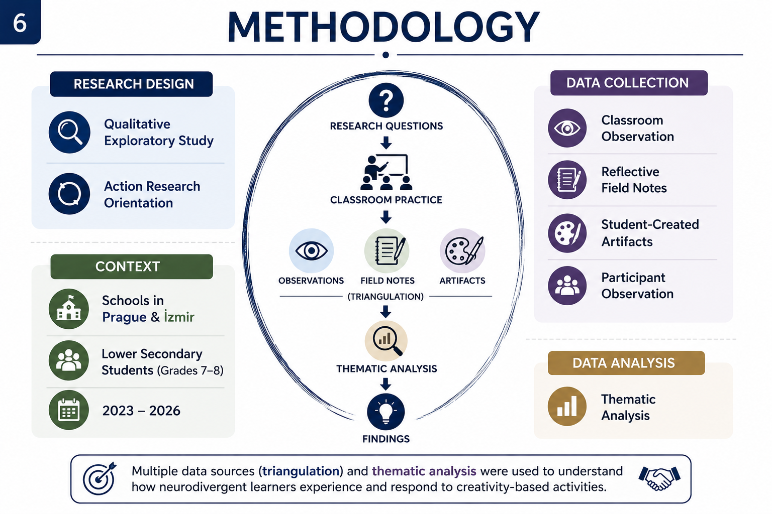

Slide 8
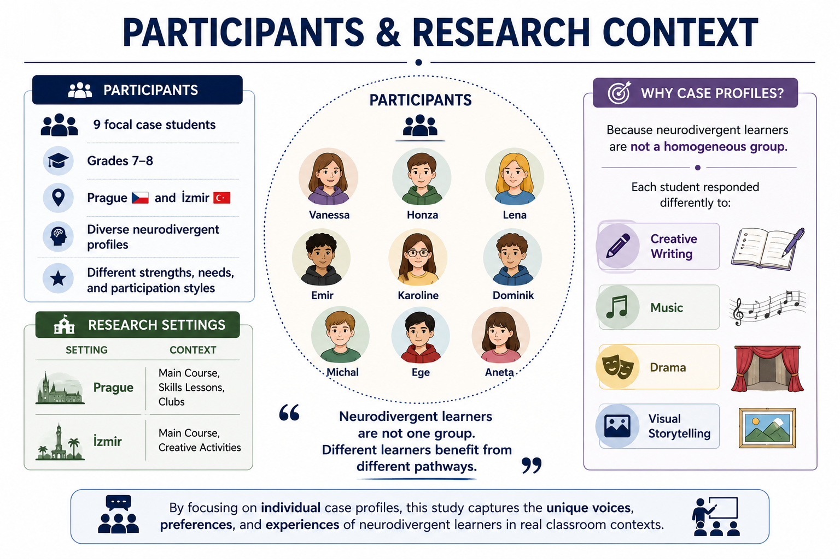


Slide 9
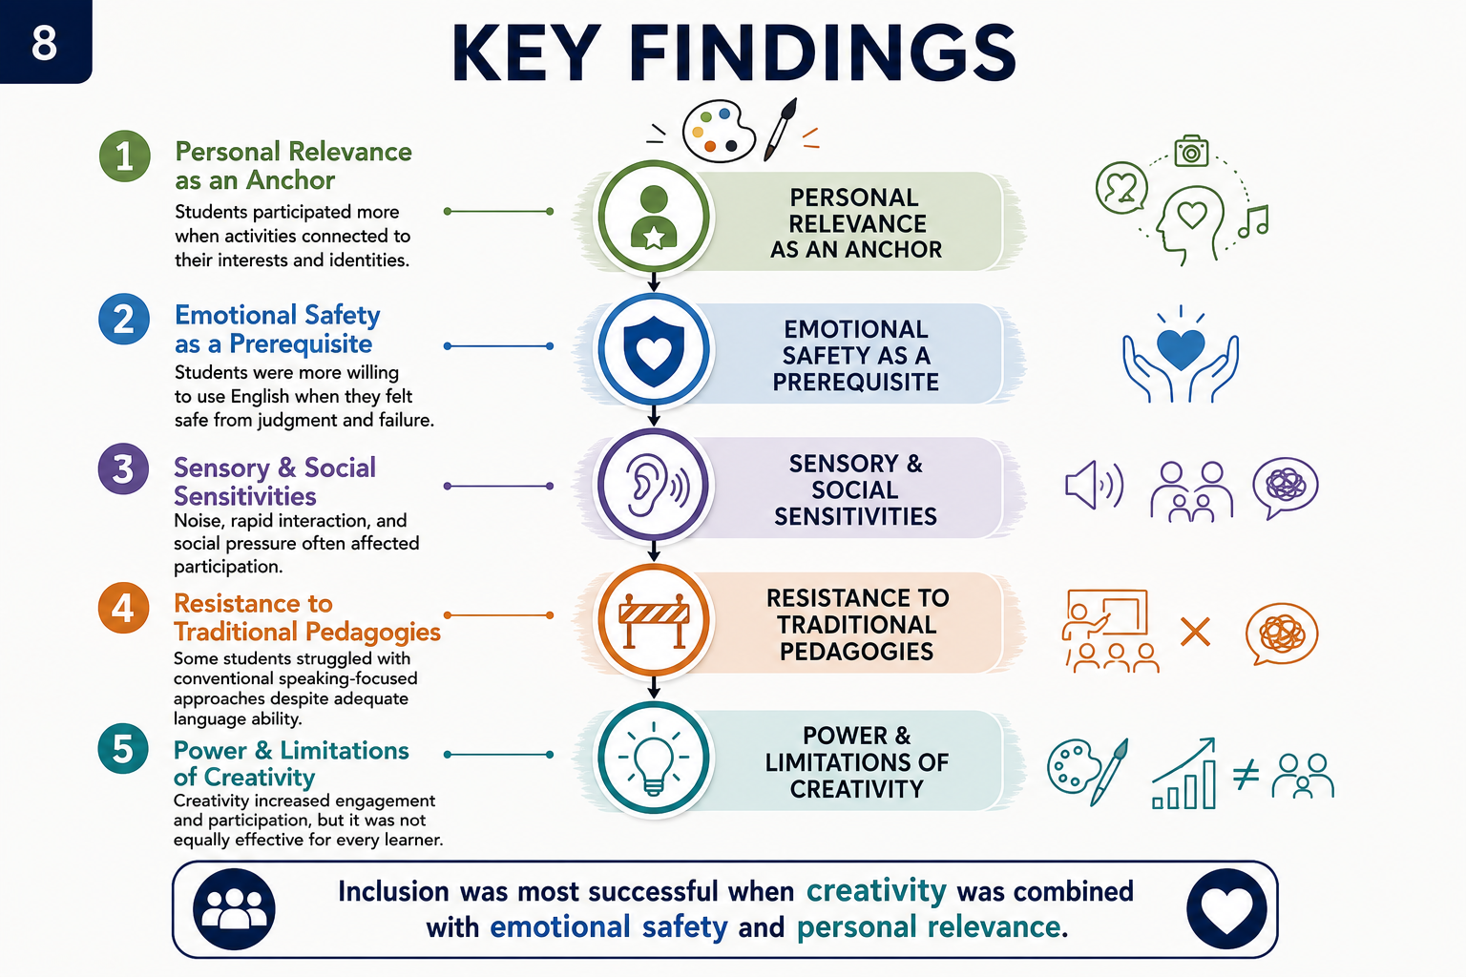

Slide 10
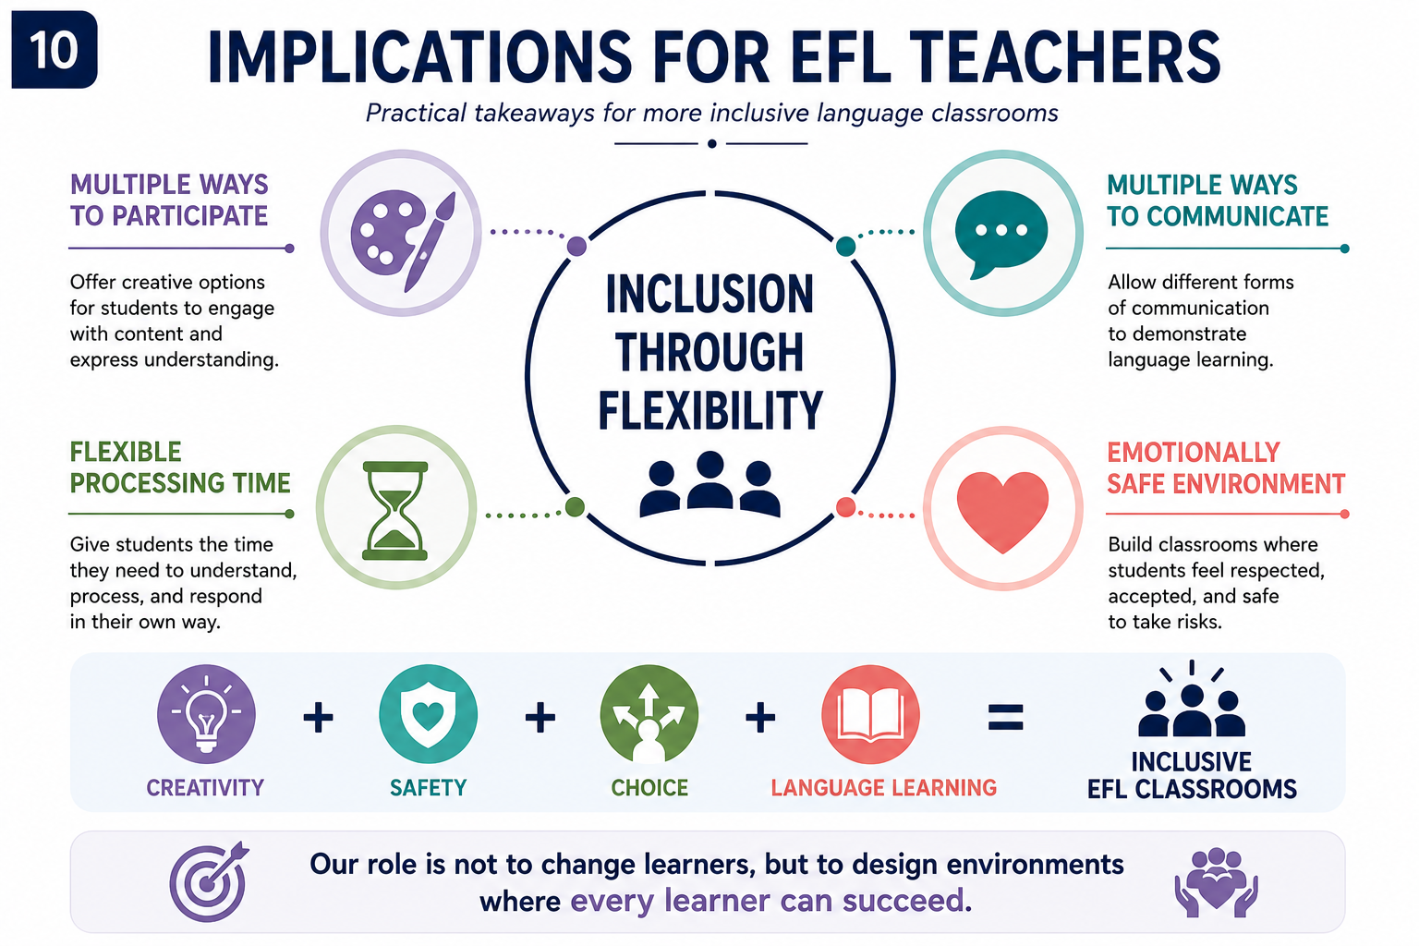

Slide 11

Question 1
In your research, you worked with students in both Czechia and Turkey. Did you observe any cultural differences in how neurodivergence is perceived or supported in these two educational contexts?
Question 2
One challenge teachers face with open-ended, creativity-based tasks is assessment. How do you recommend teachers grade or evaluate these activities in a way that remains inclusive but still aligns with institutional curriculum standards?
Question 3
How would you differentiate an activity in a way that would suit more types of learners?
Question 4
Can you suggest a lesson including activities that would include a variety of learners?
Question 5
You state: ”Creative activities offer important opportunities for student self-expression, particularly for those who may not engage with traditional textbook activities” (p 31). Is there a way to adapt the so-called ”traditional textbook activities” in a more creative/suitable way for neurodivergent learners?

Slide 12
