Slide 1
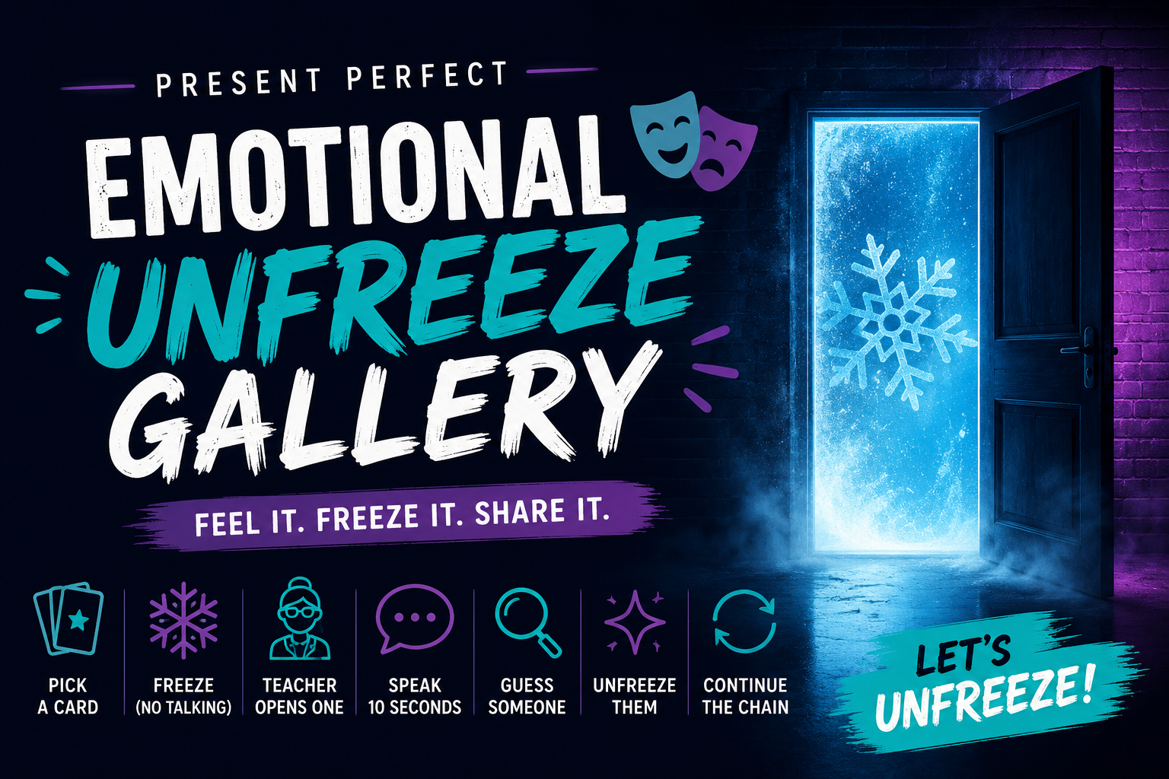

Slide 2
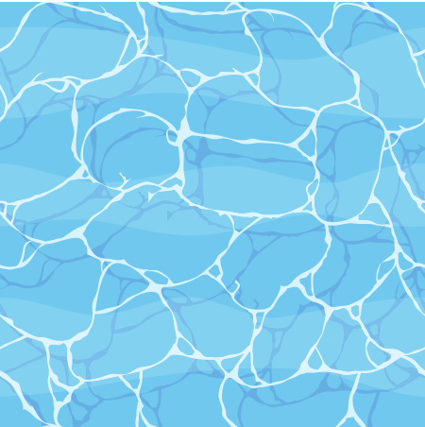





WARM
HUMAN EMOTION RADAR
Stand up.
Walk around.
Find someone who looks…
😎 confident
😴 tired
🤔 confused
🥳 excited
😨 nervous
😂 amused
UP

Slide 3
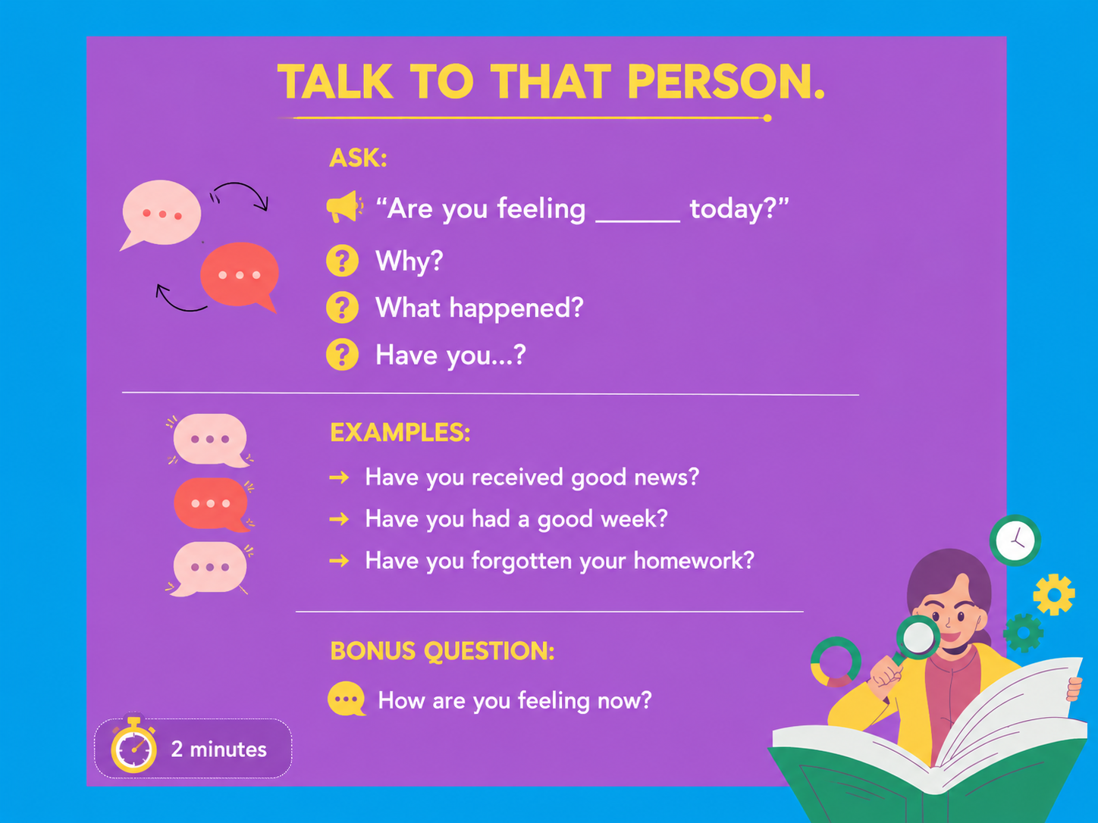


Slide 4
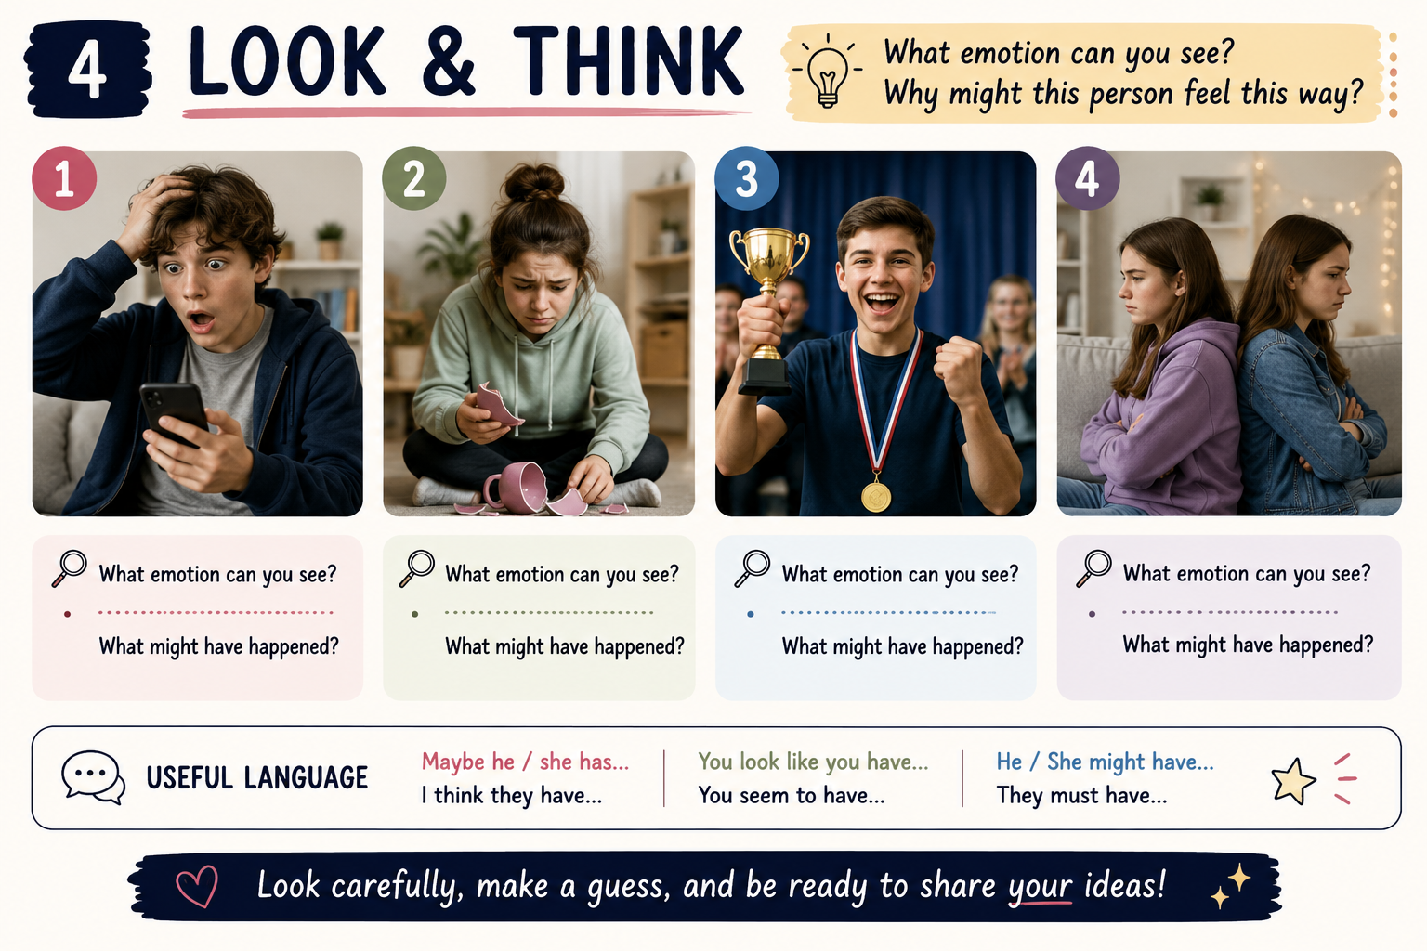

Slide 5
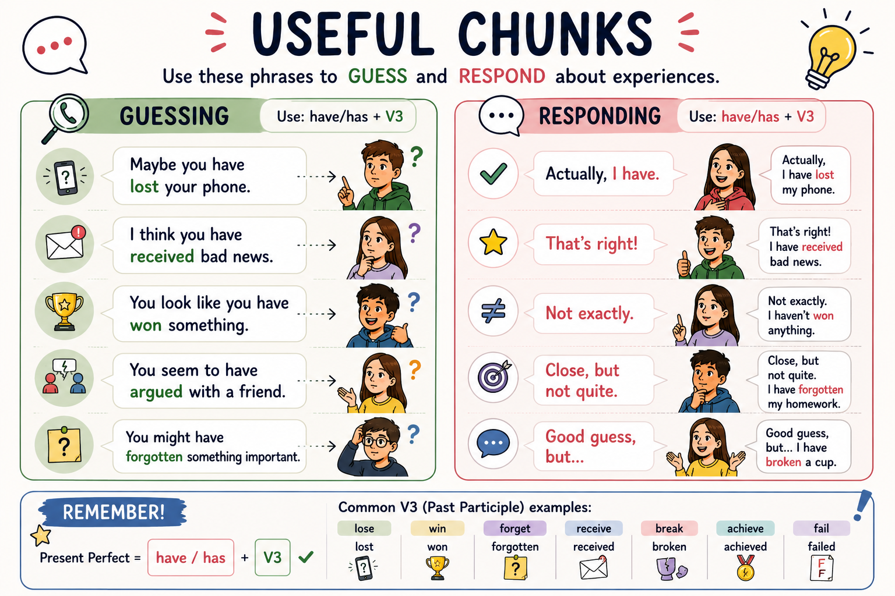

Slide 6
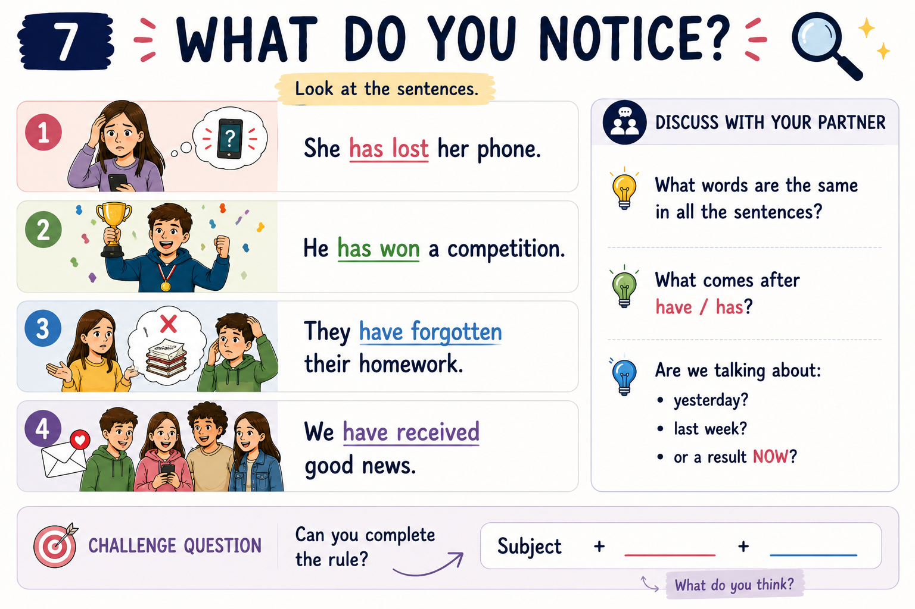


Slide 7
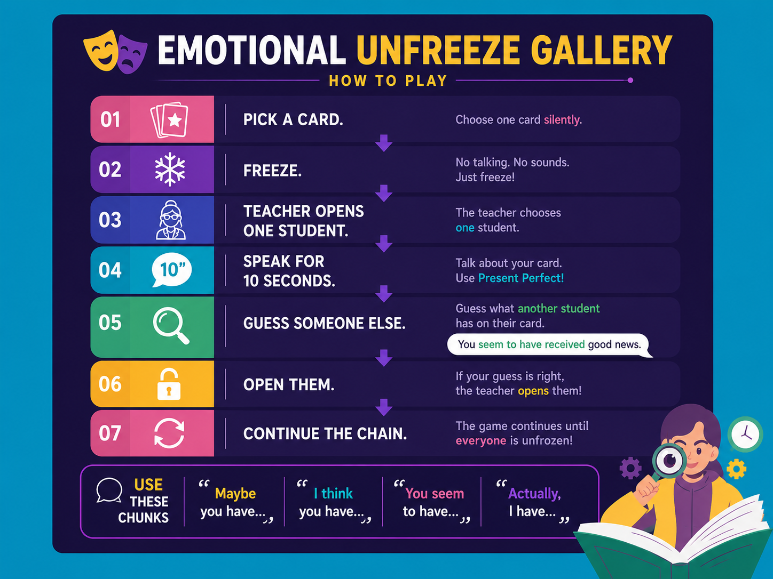

Slide 8

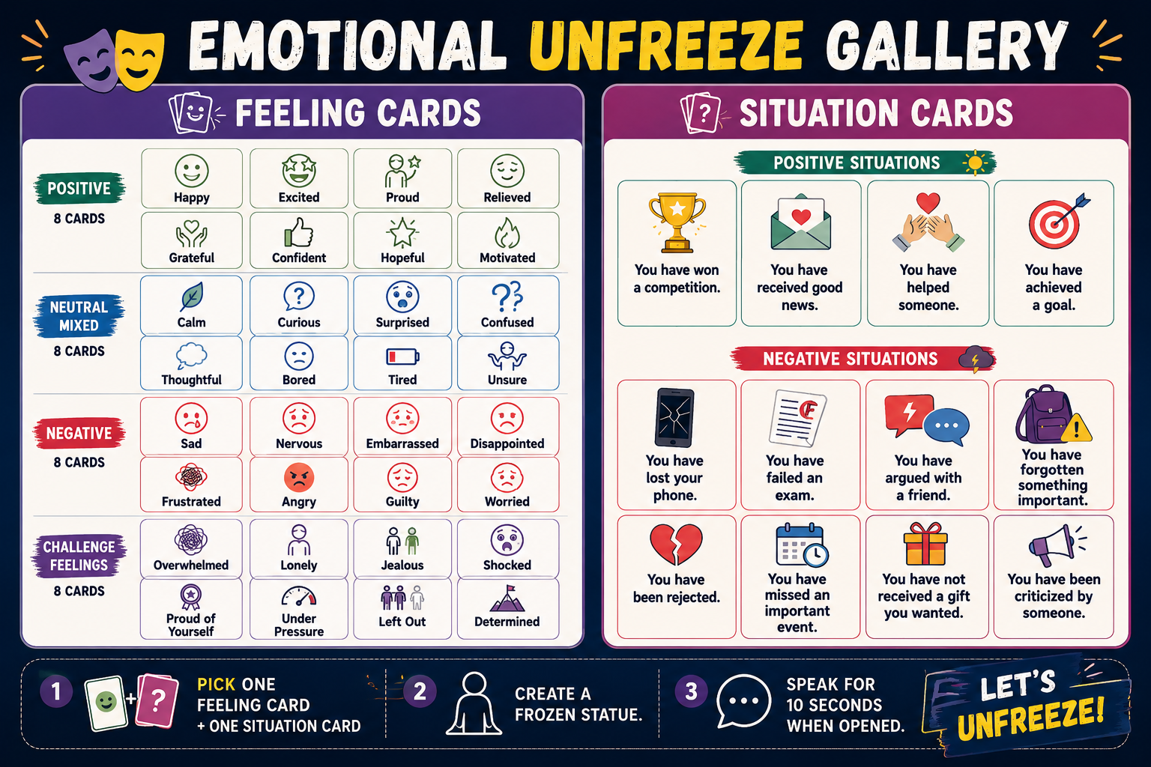


Slide 9
